Slide 1
2017-2018 Senior Design Project with
RLE Technologies: Automated PCB
1st Semester Checkpoint
The Team:
Jeremy Deutch Mechanical Engineer
Jarred Gregory Mechanical Engineer
Jessica Boyd Electrical Engineer
Indiana Hooser Electrical Engineer
Zachary Smith Computer Engineer

Slide 2
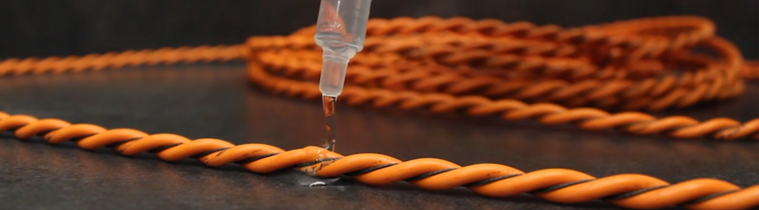
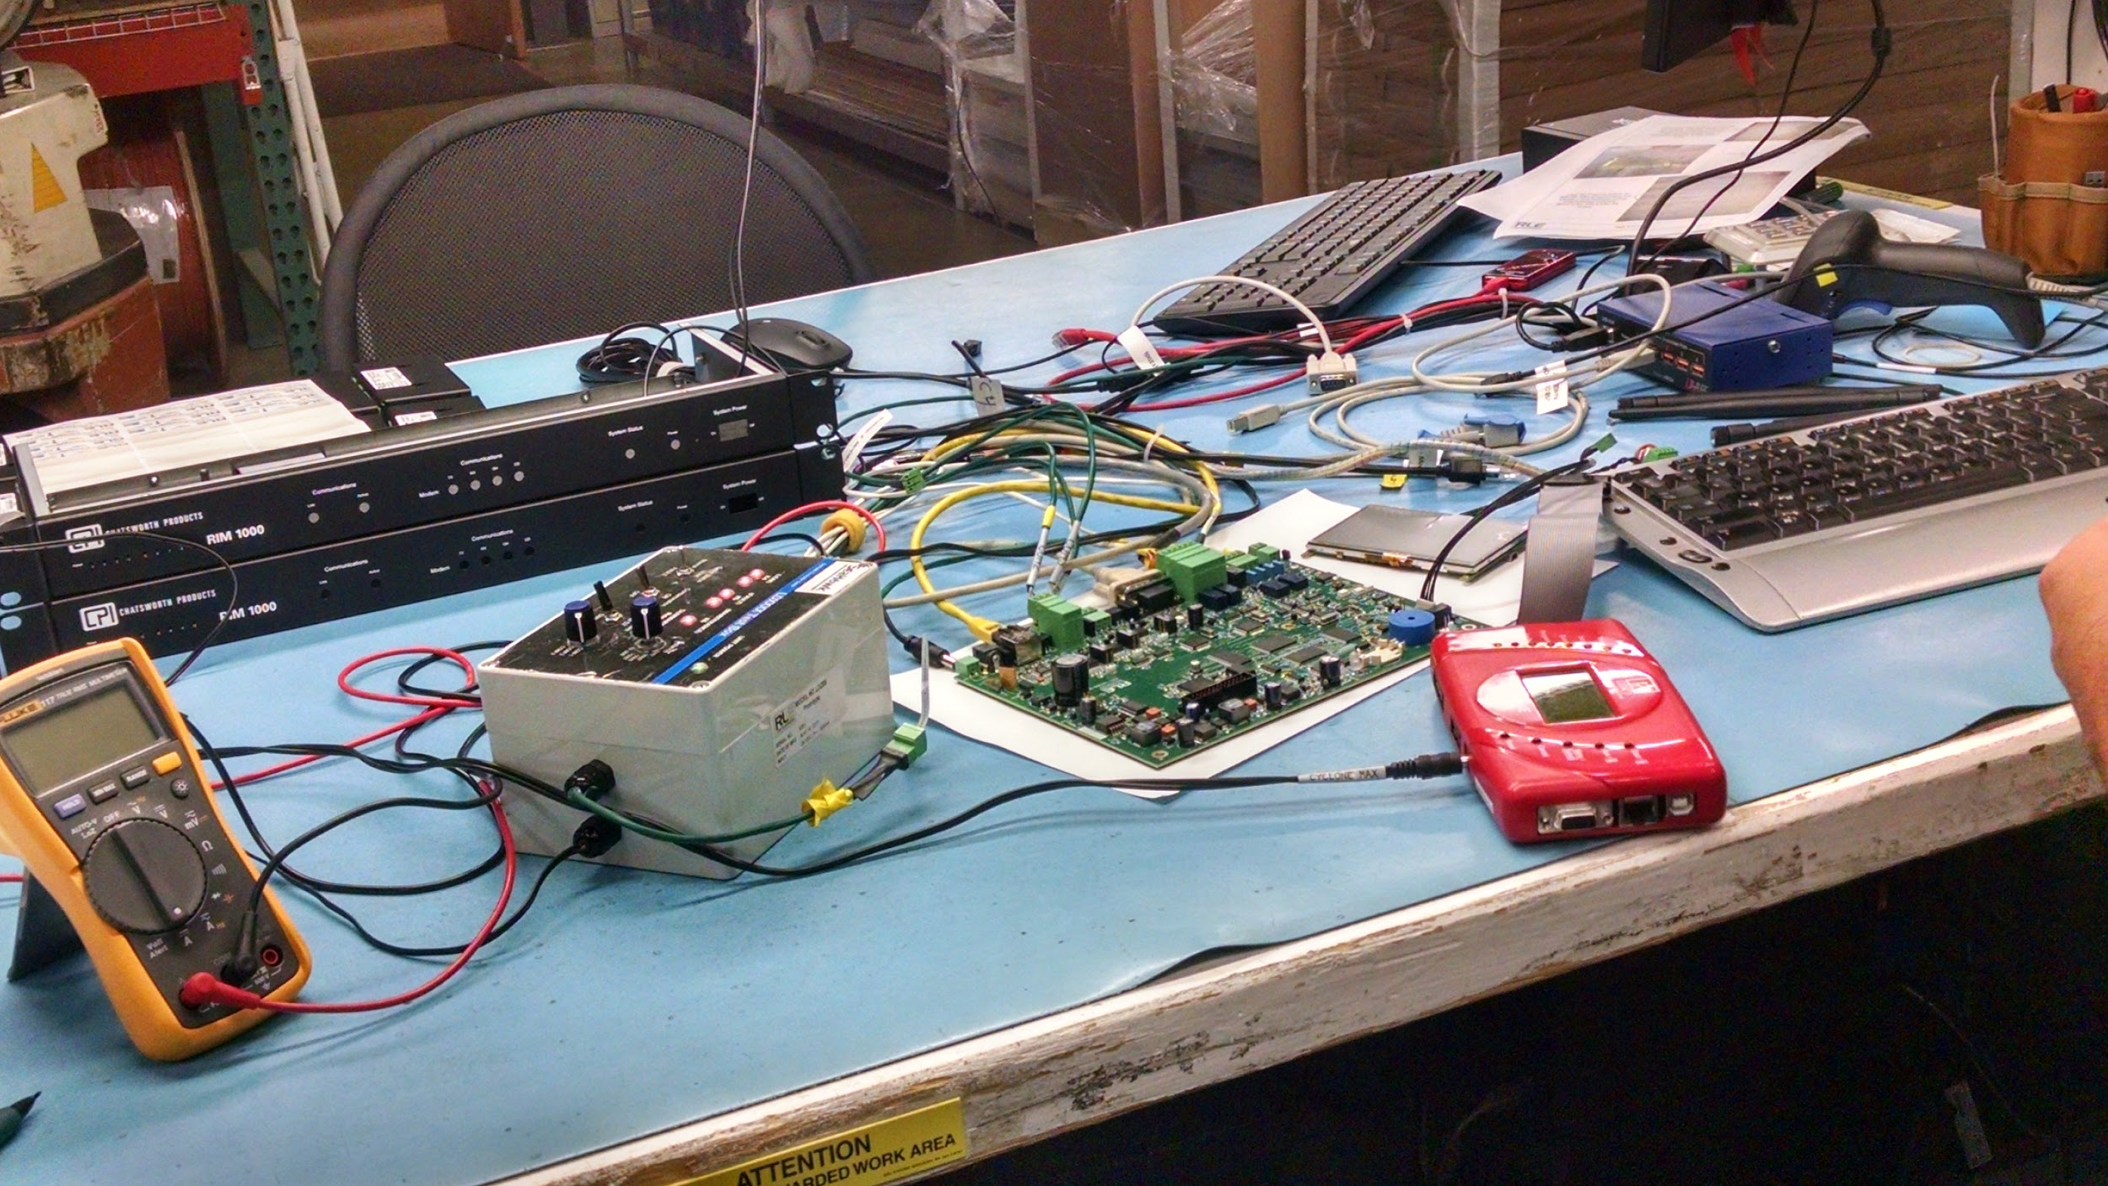
RLE
Technologies
RLE creates Leak Detection Devices. We are tasked with designing RLE an automated, highly efficient testing fixture.
Current testing setup
LD5200 PCB

Slide 3
Goals
● Reduce time spent on setting up and testing PCB boards ( < 1 hour per board)
● Test multiple units concurrently/serially (6)
● Create test system configurable for multiple products (LD5200 and LD2100)
● Create test system that emulates at least three different lengths for leakage occurrence

Slide 4
Time Budget
Activity |  | Time Required (minutes/board)
Manual | Automated | Budgeted | Actual (avg)
Plug in each boards |  | 1
 | Power Boards | 1
Load bootloader to each board |  | 5
 | Internals Test | 4 | 27.1741 s
 | Leakage Test
 | Alarm Test
 | Microphone Test
 | Fault Test
 | Contamination Test
 | Firmware installation | 1
Manual LCD testing | User feedback with active cable | 5
Detach each board |  | 2
Total |  | 19 | < 1 min
Maximum Time Accepted |  | 60

Slide 5
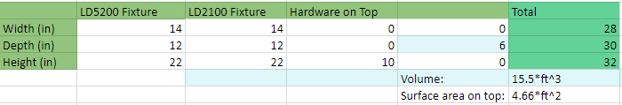
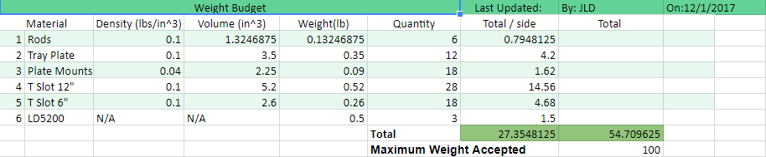
Size and Weight budget

Slide 6
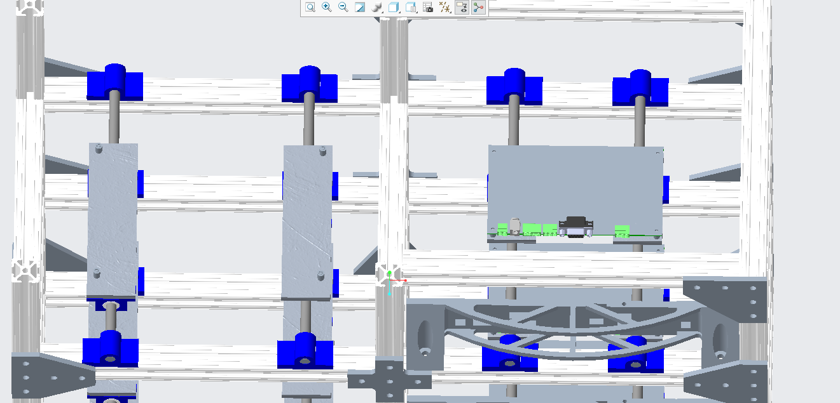
Current Work
-Mechanical
PCB Will rest on sliding tray
PCB will slide into “backplate” to make all connections

Slide 7
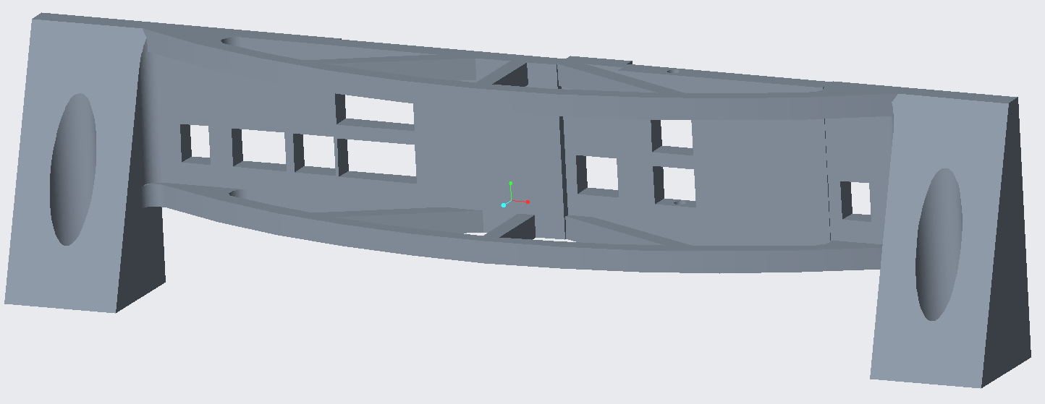
Current Work
-Mechanical
Backplate Design

Slide 8
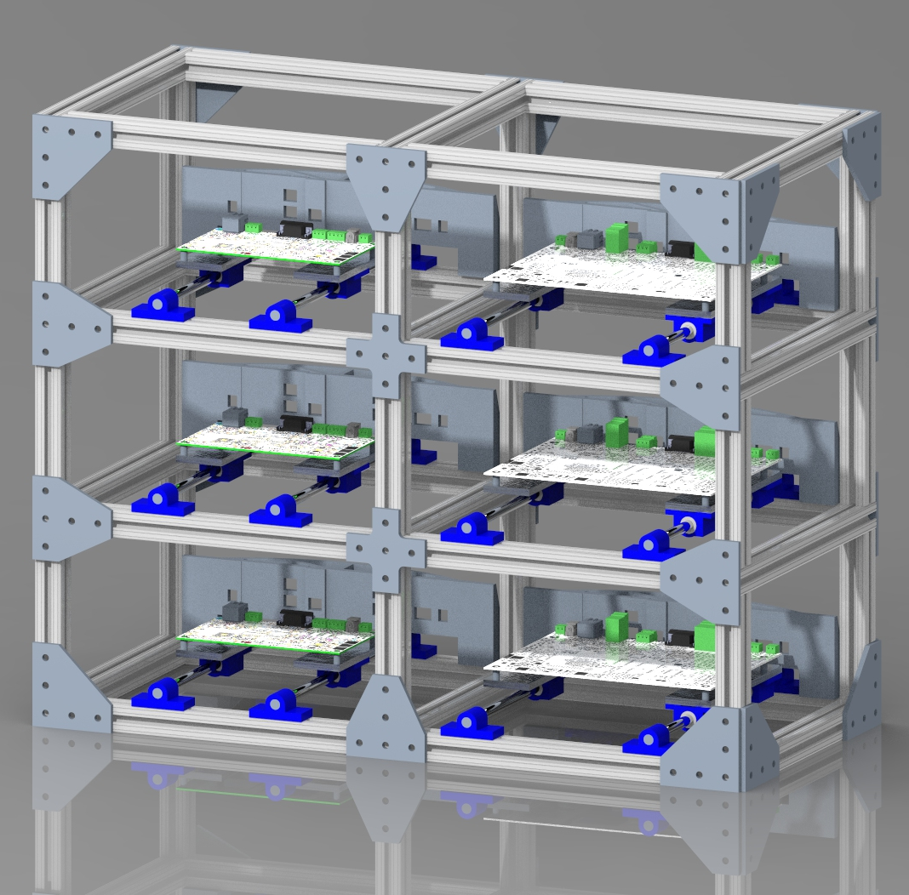
Current Work
-Mechanical
Fixture will have slots for 3 LD2100 and 3 LD5200

Slide 9
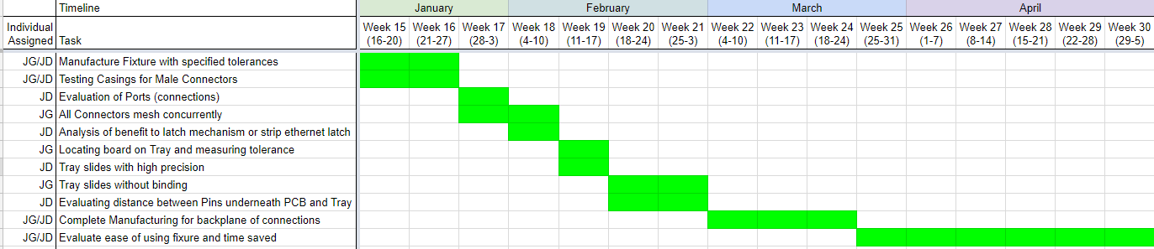
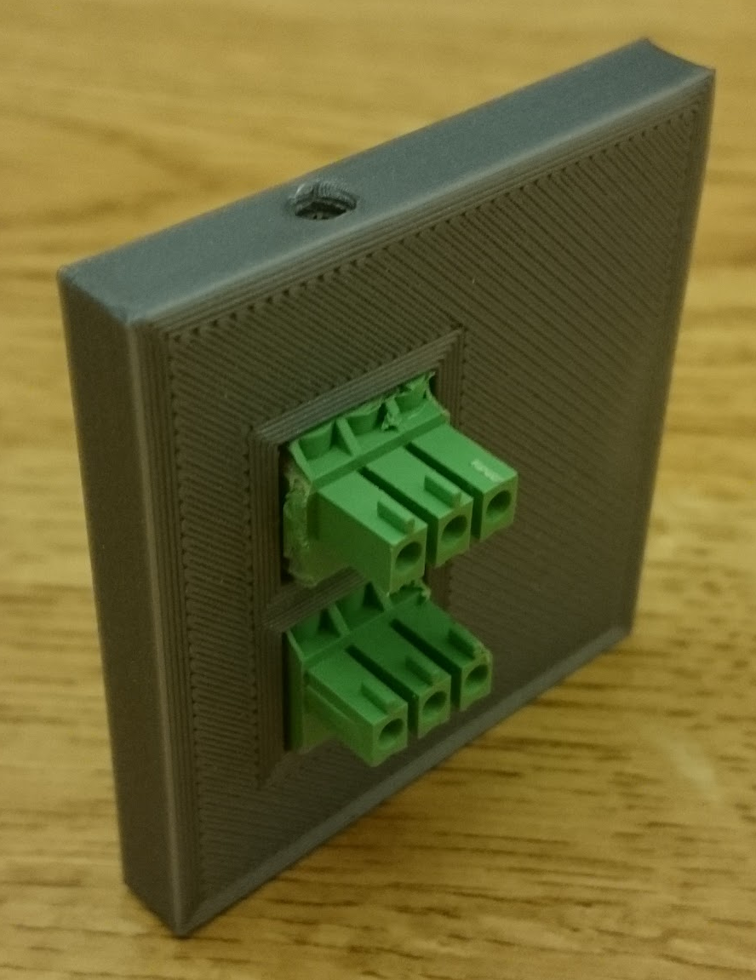
Plans for Next Semester
-Mechanical (ME)
Manufacturing
Assembly
Testing / Evaluation
3D Printed Prototype

Slide 10
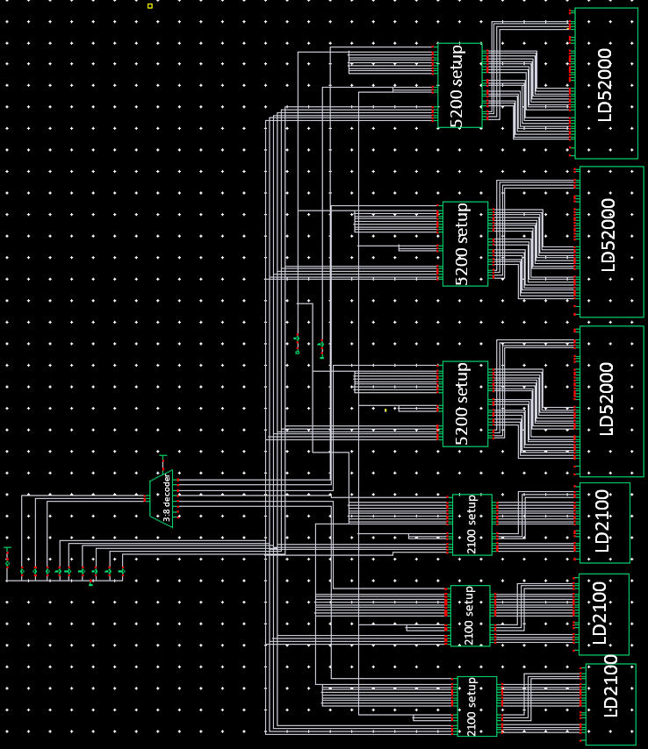
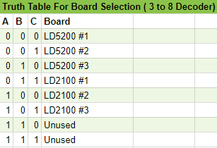
Current Work -Electrical

Slide 11
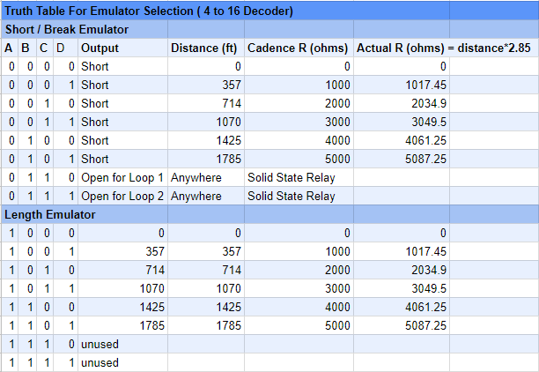
Current Work
Electrical Control
Cable Leak/Fault/Length Emulation

Slide 12
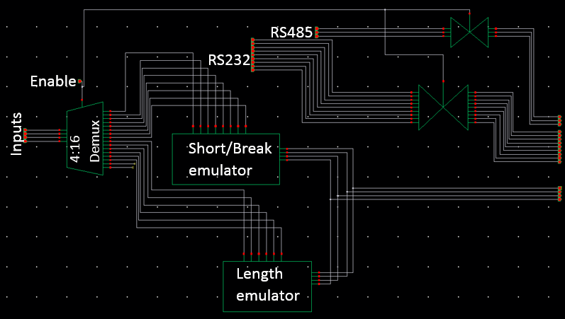
Current Work -Electrical
Setup 2100

Slide 13
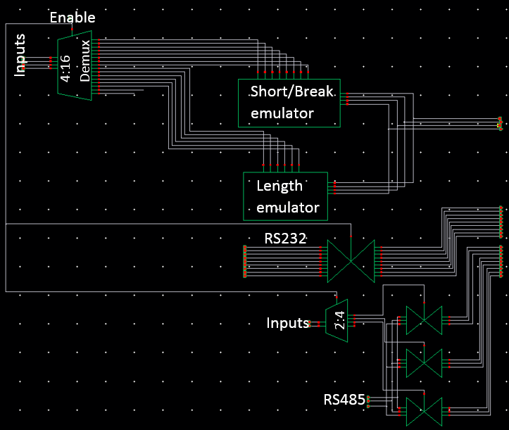
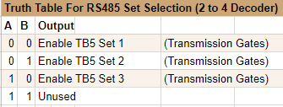
Current Work -Electrical
Setup LD5200

Slide 14
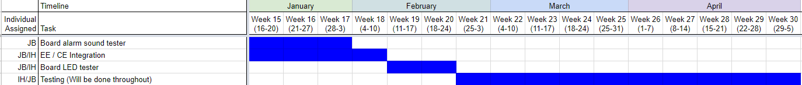
Plans for Next Semester
-Electrical (EE)
GPIO Budget | Original Total: 40 | Allocated By Rasberry Pi: 14 | Used By Sea Lion: | 9
 |  |  | Total GPIO Banks Left: | 17
USB Budget | Allocated By Rasberry Pi: 4 | Used By Sea Lion: | 5
 |  | Total GPIO Banks Left: | -1
Physically Integrating with software
LED tester
Alarm tester

Slide 15
Computer Engineering
Overview of Objectives & Technologies
Replacing manual human machine interfacing with scripting
Verifying hardware components with digital signalling
Serial communication over RS232 & RS485
9600 baud, no parity, 8 data bits, 1 stop bit
ModBus RTU over RS485
Ethernet ping validation
Display Test Results (Pass or Fail?)

Slide 16
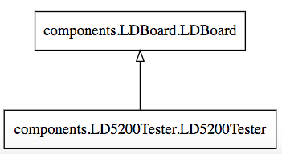
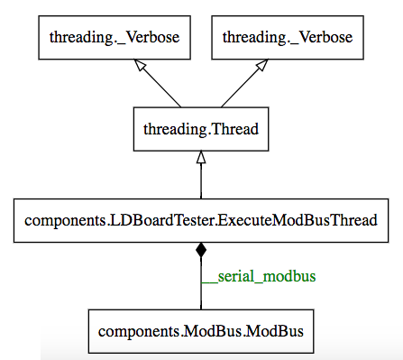
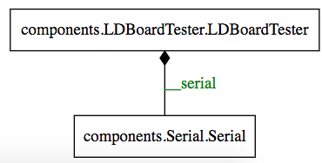
Computer Engineering
Abstractions & Object Oriented Programming

Slide 17
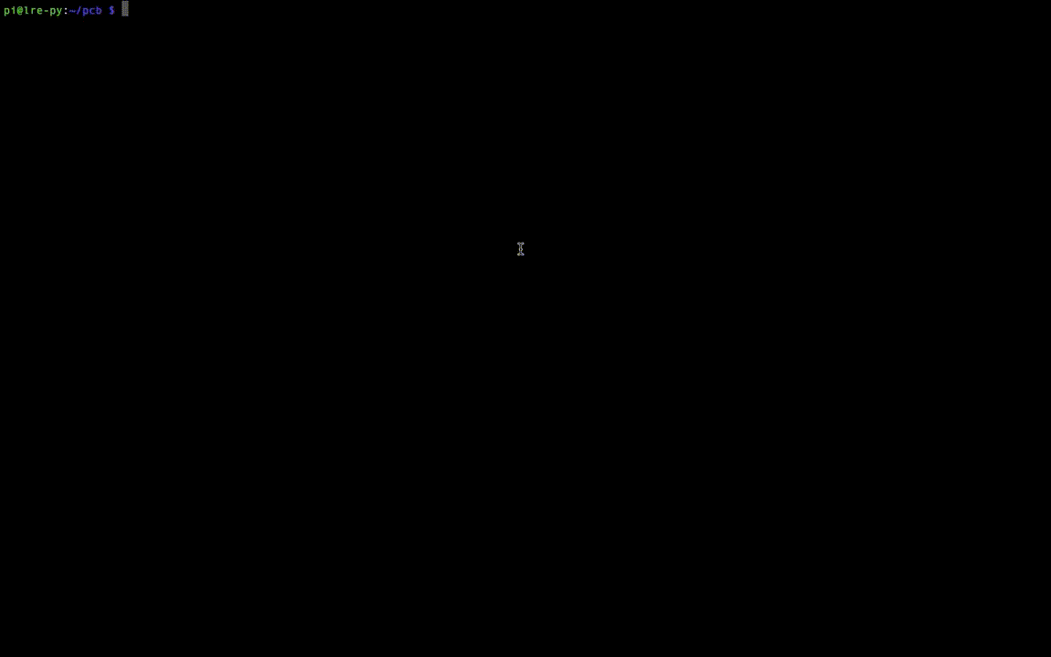
Computer Engineering
Demonstration

Slide 18
Computer Engineering
Output
Passing: True
rs232_connection: passed
datetime_set: passed
startup_sequence: passed
ps_voltage: passed
rs485_modbus: passed
ethernet_ping: passed
datetime_read: passed

Slide 19
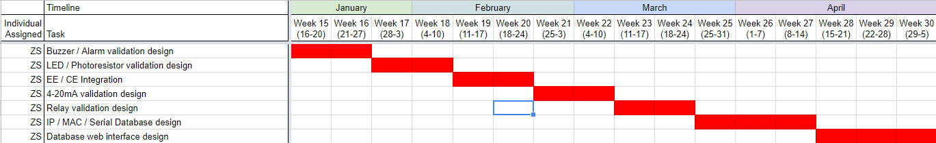
Plans for Next Semester
-Computer (CE)
LD2100 test script
Integration with EE team
Design graphical user interface
Add audible alarm, LED, current source, relay validation
Save test results by serial number to Internet facing database

Slide 20
Budget
Item | For Who | Budgeted | Actual | Difference
Network Switch | ZS | $100.00 | $68.74 | $31.26
Raspberry Pi | JB/IH/ZS | $80.00 | $49.43 | $30.57
Discrete EE Components (See EEBOM) | JB/IH/ZS | $220.00
RS 232 / USB Adapter | ZS | $69.00 | $69.00 | $0.00
RS 485 / USB Adapter | ZS | $89.00 | $89.00 | $0.00
Stripboard | JB/IH | $14.00
Female Terminal Blocks | JG | $0.00 | Acquired from RLE | $0.00
Extruded Aluminum Framing (T-Slot) | JD | $100.00
Aluminum Base Plates (For PCB Alignment) | JG | $90.00
Locating Dowel Pins | JD | $10.00
Rods | JG | $80.00
T-Slot Fasteners | JD | $20.00
Linear Bearings | JG | $270.00
Mounts | JD | $100.00
Unexpected Expenses | JG/JD/ZS/IH/JB | $100.00
Sum |  | $1,342.00 | $276.17
$1,342 expected
$276 spent

Slide 21
Budget EE Specific
Electrical Bill of Materials (EEBOM)
Description | Units | Units Cost Low | Cost Low | Units Cost High | Cost High
4 to 16 Decoder | 6 | $0.56 | $3.36 | $2.80 | $16.80
3 to 8 Decoder | 1 | $0.56 | $0.56 | $2.80 | $2.80
2 to 4 Decoder | 3 | $0.56 | $1.68 | $2.80 | $8.40
1 to 2 Decoder | 0 | $0.56 | $0.00 | $2.80 | $0.00
Optoisolator | 12 | $0.40 | $4.80 | $1.13 | $13.56
~Photo Resistor | 6 | $0.89 | $5.34 | $2.22 | $13.32
~Microphone | 1 | $0.35 | $0.35 | $20.00 | $20.00
~Power Supply | 1 | $6.00 | $6.00 | $10.00 | $10.00
USB Extension Bus | 1 | $4.44 | $4.44 |  | $0.00
GPIO Extension Bus | 0 | $7.04 | $0.00 | $12.99 | $0.00
Transmission Gate | 90 | $0.17 | $15.30 | $0.53 | $47.70
Mosfet Transistors | 96 | $0.05 | $4.80 | $0.40 | $38.40
Precision Resistors (+-.1%) | 108 | $0.21 | $22.68 | $0.60 | $64.80
Total Expected Cost Design 1 |  |  | $69.31 |  | $235.78
Funds Left from $220 for Unexpected Costs |  |  | $150.69 |  | -$15.78

Slide 22
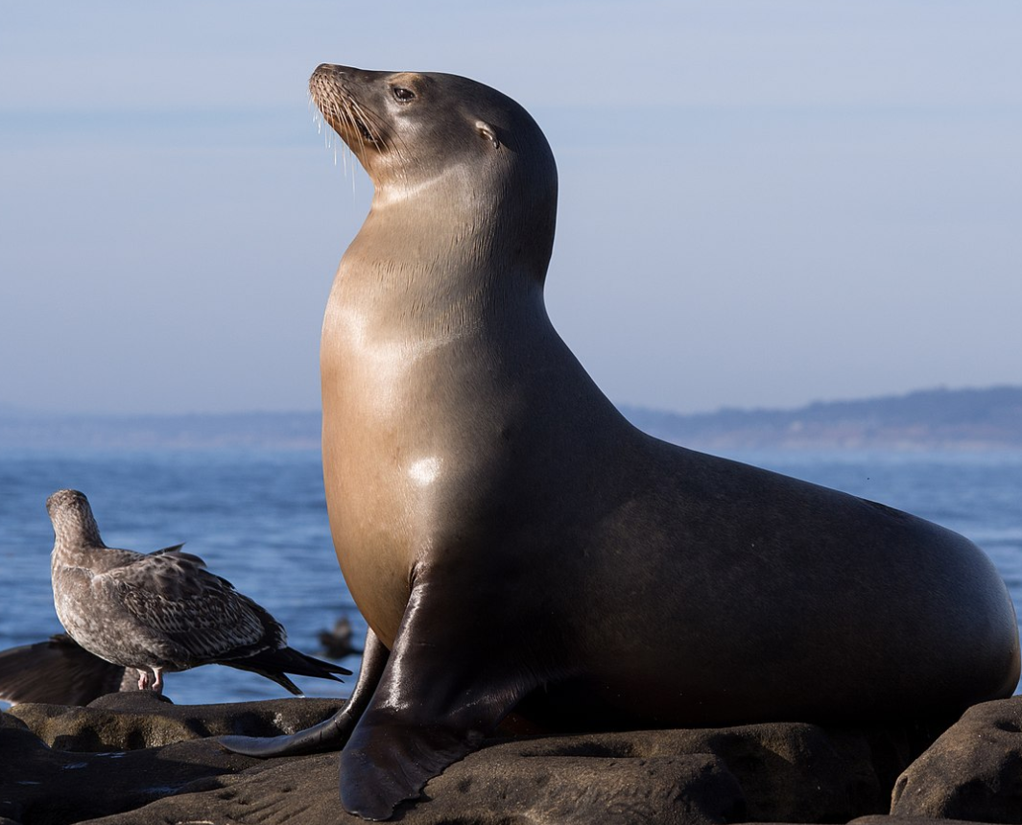
Thank You
From Team SeaLion (Automated PCB)

